Slide 1
Infections in a Pregnant Mother
Clinical aspects
Dr. Nadisha Badanasinghe
Senior Lecturer
Dept. of Medical Microbiology

Slide 2
Objectives
Why infections are problematic in pregnancy?
What are the common infections which pose problems in pregnancy?
How do you manage these infections?

Slide 3
What are the problems with pregnancy?
Low immune status in mother
    To prevent rejection of semi-allogeneic foetus
    Adaptive immune responses are weakened
    Boosted innate response
    Some infections are more severe in pregnancy (ex. Malaria, influenza, etc)
    Some infections are reactivated in pregnancy (HSV, CMV)
Foetus has poorly developed immune system
    IgM and IgA - Very low
    No IgG
    Low CMI

Slide 4
Problematic infections
UTI
PROM/ intra-amniotic infections
  GBS
Infections which cause congenital infections
  Varicella
  Rubella
  CMV
STI
Infections which can be severe in pregnancy
  Chickenpox
  Influenza
  Malaria
  Hep E
Post partum
  Endometritis
  Mastitis/ Breast abscess

Slide 5
Case 1
POA 20 weeks, uneventful
P2C1
No significant past history
Urinary culture report
  Coliform> 10⁵ C.F.U
No symptoms

Slide 6
UTI
The most common medical complications during pregnancy
  asymptomatic bacteriuria - 2–10 %
  acute cystitis- 1–4 %
  Pyelonephritis – 0.5-2%
Risk begins in week 6 and peaks during weeks 22 to 24
Asymptomatic bacteriuria → 20-40% develop symptomatic pyelonephritis later if untreated
  Also lead to premature delivery/IUGR/ LBW

Slide 7
UTI in Pregnancy - Pathogenesis
Relaxation of muscles in ureters and bladder → dilatation→ stasis and reflux
Dilatation of ureters and renal pelvis
physiologic increase in plasma volume during pregnancy decreases urine concentration
Up to 70 percent of pregnant women develop glycosuria, which encourages bacterial growth in the urine

Slide 8
UTI pathogens
Similar to a non pregnant female
  E. coli – 80-90%
  Other coliforms
  GPC
    S. saprophyticus, enterococci, Grp. B Streptococci

Slide 9
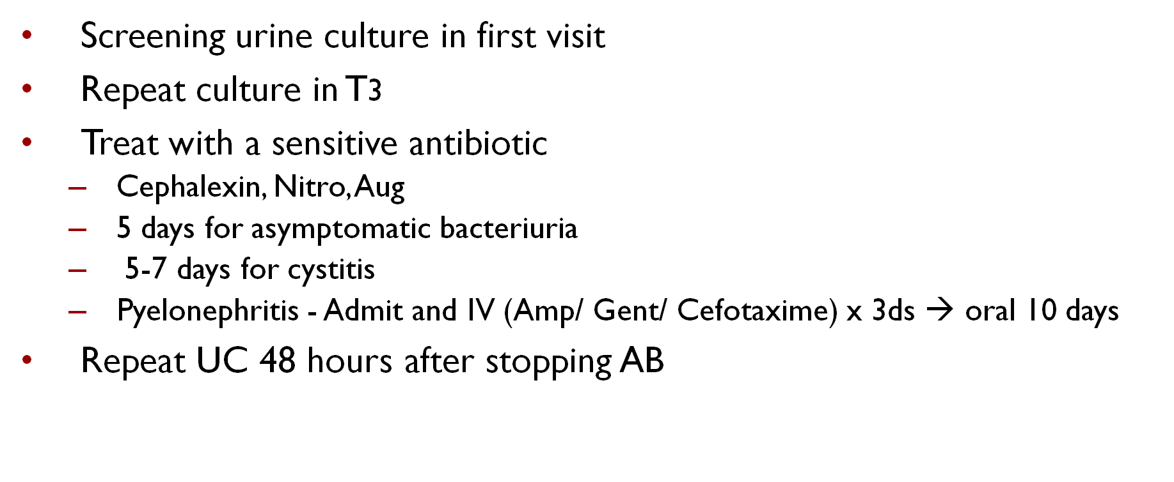
Management

Slide 10
Case 2
POA 35 weeks
Dribbling for ~ 24 hrs
Back pain
Fever

Slide 11
Prolonged PROM
Prolonged PROM refers to ROM greater than 24 hours
If membranes rupture prematurely (<37 wks), higher risk of latency
Associated with an increased risk of ascending infection
→ infection complications in foetus
→ infection complications in mother

Slide 12
Intra-amniotic Infection (Chorioamnionitis)
Infection of the uterus and it`s contents during pregnancy
Most cases are ascending in origin, occurring after prolonged rupture of membranes
  Few cases from transplacental spread and bacteremia e.g Listeria monocytogenous
  Rare cases after diagnostic amniocentesis
Risk factors: PROM, young age, nullparity and Bacterial vaginosis

Slide 13
Presentation
Maternal
Fever
Tachycardia
Uterine tenderness
Uncommom: foul smelling or grossly purulent Amniotic fluid
Fetal
Fetal Heart rate abnormalities
Preterm labour
Causes arrest of progress of labour
Neonatal sepsis
Neonatal death/ stillbirth

Slide 14
Organisms isolated
Polymicrobial vaginal flora
E.coli
Group B Streptococci
Enterococci
Other coliforms
Gardnella vaginalis
Mycoplasma hominis
anaerobes

Slide 15
Management
Antibiotics started as soon as suspected not postpartum
Antibiotic administration reduces frequency of neonatal pneumonia, bacteremia and cures maternal infection
As Group B Streptococci and E .coli are the most common isolates from newborn, combination of Ampicillin or Penicillin and Gentamicin are used

Slide 16
Group B streptococcus
Pregnant mother
26% in US
25% in UK
19% Asia
Ethnicity, young age, IUD, diabetes
Vaginal colonization with GBS
1-2% transmission rate
Intensity of colonization
Intra-partum antibiotics
Colonized neonate
3-12% develop bacteraemia
Preterm, Prolong PROM, LBW
Neonatal sepsis
5-10% mortality

Slide 17
Group B streptococcus
Important pathogen in early and late onset neonatal sepsis
Management
  Screening-based strategy
    vaginal and rectal swab specimens at 35–37 weeks POA
    intrapartum penicillin to women with GBS +
    Reduced early onset sepsis
    Problems
      Antibiotic resistance
      No reduction in late onset sepsis
      Prenatal cultures are not always predictive of colonization at delivery

Slide 18
Case 3
POA 12 weeks
Exposed to chicken pox ~ 1 day
Uncertain past history of chicken pox

Slide 19
Chicken pox
~ 10% of women in childbearing age are susceptible
Occur 0.01% of all pregnancies
Transplacental infection in T1< 3%
Can affect the foetus if it occurs in early (foetal varicella syndrome) or very late pregnancy (neonatal varicella)

Slide 20
Chicken pox in pregnancy
Effects in Foetus
  No damage
  Still birth
  Foetal Varicella Syndrome (in first half of pregnancy – within 28 weeks)
    skin scarring, limb hypoplasia, visceral, neurological and eye lesions
Effects in mother
  Severe chicken pox

Slide 21
Chicken pox significant exposure
Check IgG Abs
  Seropositive – No action required
  Seronegative/ Serology not available
    Give VZIG as soon as possible
    Can be given upto 10 days after exposure
    Advice to seek medical attention immediately if chickenpox develops
    Non-immune pregnant women who have been exposed to chickenpox should be managed as potentially infectious from 8–28 days after exposure
    VZIG is indicated after significant exposure to VZV at any stage of pregnancy, and postnatally if birth occurs within 10 days of exposure

Slide 22
Case 4
POA 20 weeks
Fever, chickenpox like rash ~ 2 days
No history of childhood chickenpox

Slide 23
Management of Chickenpox in pregnancy
Medical review is essential
<24 hrs since onset of rash → oral aciclovir
> 24 hrs since onset of rash → No aciclovir
No benefit from VZIG once the rash develops
If low risk of complications → manage at home
High risk group → monitor in hospital
  Isolate from other pregnant mothers, babies and nonimmuned staff

Slide 24
Complicated / Severe chickenpox
Treat with IV aciclovir
Supportive therapy
Consider CS if
  Foetal compromise
  Maternal respiratory failure
Complications
  Atypical pneumonia
  CNS – acute encephalitis, benign cerebellar ataxia

Slide 25
Chickenpox exposure just before delivery
Actual risk of child getting the infection depends on
  The rapidity of antibody production in mother and crossing the placenta
  The time interval b/w the date of onset of rash in the mother and date of delivery
  Rash develops 7 days before delivery
    Abs cross placenta
    Foetus cope remarkable well
    Baby does not develop severe disease
  Rash develops 6 days or less before delivery or upto 7 days after delivery
    Virus cross placenta
    No protective Abs to foetus
    Baby develops severe disseminated varicella with pneumonia and encephalitis
    So, neonates should receive prophylactic VZIG soon after delivery

Slide 26
STI
Syphilis
  pregnant women with untreated early syphilis,
    70% chance of transmitting the infection to her fetus
    25% of pregnancies result in stillbirth
    14% in neonatal death
    overall perinatal mortality of about 40%
  Routine screening
  Treatment with single IM benzathine penicillin for primary, secondary, and early latent syphilis in pregnancy, and three doses one week apart for late latent syphilis

Slide 27
STI
HIV
  Transmitted to foetus/ neonate through placenta, birth canal, breastfeeding
  Increased risk with high viral load, young maternal age, low CD4 count, Prolonged PROM, vaginal delivery, other STIs
  Maternal anti retroviral therapy significantly reduce the mother-child transmission
  zidovudine, nevirapine, or a combination of the two, are recommended during pregnancy to reduce mother-to-child transmission of HIV
  Other interventions
    Screening
    Counseling
    EL-LSCS before onset off labour
    Neonatal post exposure prophylaxis with ARV

Slide 28
STI
HBV infection
  Transplacental and perinatal transmission
  Acute HBV infection during pregnancy usually is mild and not associated with teratogenicity or mortality
  Unless the patient has acute liver failure, antiviral therapy is usually unnecessary
  Treatment is mainly supportive, with monitoring of liver biochemical tests
  To reduce transmission to baby:
    Screening and monitoring of viral load
    All babies born to positive mothers should receive Hep B Immunoglobulin and Hep B vaccine within 12 hours of delivery

Slide 29
STI
Gonorrhoea/ Chlamydia infection
  Pre-term labour, PPROM, Chorioamniionitis, Endometritis
  opthalmia neonatorum (40-50%), Pneumonia (18%)
  Most are asymptomatic
  Screening in high risk population and treatment

Slide 30
Other severe infections
Influenza
  Pregnant women are at high risk for severe complications of influenza during seasonal influenza periods and pandemics
  some studies suggest an increased risk for adverse outcomes among infants born to mothers infected with influenza during pregnancy
  CDC Recommendations:
    influenza vaccine for all pregnant women in any trimester during flu season.
    Pregnant women with symptoms of influenza should be tested and treated immediately

Slide 31
Other infections
Hep E
  risk of fulminant disease and maternal mortality occurs in 20% of patients when disease presents during the third trimester
  Vertical transmission- rare
  No specific treatment available
  Supportive therapy

Slide 32
Other Infections
Zika virus
  Febrile illness ~ dengue
  Transmitted by Aedes mosquitoes
  based on a growing body of research there is scientific consensus that Zika virus is a cause of microcephaly and other congenital anomalies
  Risk higher with infection in T1
  Outbreak in Brazil started in 2015 → spreading central/ south America, Caribbean, pacific, Thailand, Philippines, Vietnam
  Diagnosis – Pregnant mothers with recent travel + symptoms
    Serum for PCR (within 2 weeks of travel)
    4 weekly USS
  Treatment - supportive

Slide 33
Case 5
EM-LSCS performed in a 36 weeker with prolonged ROM, and lack of progress.
Developed fever following LSCS with high WBC and CRP

Slide 34
Post-partum Endometritis
Postpartum infection of the uterus
Most common cause of puerperal fever
Predominant predictor: Caesearan section particularly after labour or premature rupture of membranes
  Rates vaginal delivery 0.9-3.9%
  Caesearan section rate: 10-50%
Secondary risk factors include BV
Presents with
  Fever on 1st or 2nd day postpartum
  Lower abdominal pain
  Uterine tenderness
  Leucocytosis

Slide 35
PP Endometritis
It is a polymicrobial Infection
Endometrial isolates: Group B Streptococci, enterococci, G.vaginalis, E.coli, Prevotella bivia, Bacteroides spp and Peptostretococcus
Blood isolates: Group B Streptococcus and G.vaginalis most common
Treatment: intravenous antibiotics

Slide 36
Case 6
2 weeks post delivery
Breastfeeding
Fever
Pain and swelling in L/ breast
Localized inflammed area

Slide 37
Mastitis/ Breast abscess
Present with Inflammation+/- infection +/- abscess (3%)
Associated with
  Damaged nipple, poor breastfeeding practice, missed feeds, stress
  Mostly within 8 weeks after delivery
Management
  Physiological – correct breastfeeding, expressing, massage, apply warmth
  Treatment – analgesics
    Antibiotics - If symptoms are not resolving within 12 to 24 hours with physiological methods or if presenting symptoms are moderate or severe
    Most common organisms- S. aureus (less commonly Streptococcus or Escherichia coli)
    Oral flucloxacillin/ cephalexin x 5 days
    If not responding to first line AB/ severe mastitis – hand expressed mid stream breast milk culture and ABST

Slide 38
Summary
Infections in pregnancy
  Risk to baby
  Risk to mother
Clinical suspicion
Adequate investigations/ screening
Adequate treatment
  Antibiotics/ antivirals should be safe to use in pregnancy

